Slide 1
Cognitive Psychology
Chapter-5
Raheela Tariq

Slide 2
Definition
Cognitive psychology is the scientific study of mental processes such as "attention, language use, memory, perception, problem solving, creativity, and thinking".
In other words, cognitive psychology is interested in what is happening within our minds that links stimulus (input) and response (output).

Slide 3
TYPES OF THINKING
Autistic thinking preoccupation with inner thoughts, daydreams, fantasies, private logic; egocentric, subjective thinking lacking objectivity and connection with external reality.
Realistic Thinking is controlled, constructive, directive, realistic and factual based thinking.

Slide 4
COGNITIVE PSYCHOLOGY
Cognitive psychology is the scientific study of mental processes such as "attention, language use, memory, perception, problem solving, creativity, and thinking".
In other words, cognitive psychology is interested in what is happening within our minds that links stimulus (input) and response (output).
As part of the larger field of cognitive science, this branch of psychology is related to other disciplines including neuroscience, philosophy, and linguistics.

Slide 5
Uses of Cognitive Psychology in Computer Programming
Understanding, Planning, and Logic
  Capacity
  Knowledge
  Association
  Objects
Imaging and Creativity
  Analogies for program functions
Attitude and Work
  Behavior
  Team Work

Slide 6
Artificial Intelligence
Artificial intelligence (AI) involves the study of cognitive phenomena in machines. One of the practical goals of AI is to implement aspects of human intelligence in computers. Computers are also widely used as a tool with which to study cognitive phenomena. Computational modeling uses simulations to study how human intelligence may be structured.

Slide 7
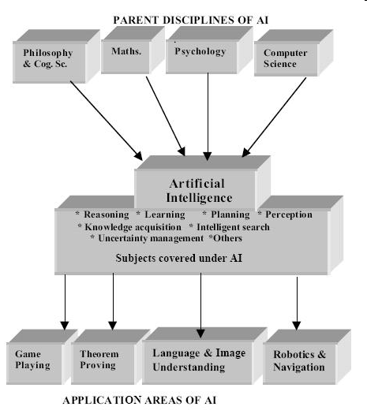

Slide 8
Tools of Thoughts:
Language is a form of communication that is:-
Based on system of symbols.
Through written and spoken.
Rules of language:
Phonology (study of language by sound system) No language uses all phonemes. On average every language uses 20-80 phonemes. For example, English language contains 40 phonemes (roughly making 26 letters).
Morphology (they are meaningful strings of sound that contains no smaller meaningful parts)
Syntax (the way words are combined to form acceptable phrases and sentences)
Semantics (giving meaning to your words)

Slide 9
Phonemes (Phonology)
They are at the base of language hierarchy.
Smallest speech unit in language.
English dictionary contains more than 450,000 words.
Humans are only capable of recognizing 100 such basic sounds.
No language uses all phonemes. On average every language uses 20-80 phonemes. For example, English language contains 40 phonemes (roughly making 26 letters).

Slide 10
Morphemes (Morphology)
They are the smallest units of meaning in a language.
Approximately 50,000 English morphemes are there that include root words, prefixes & suffixes.
For example, the word “unfriendly” consists of three morphemes. The root word friend, the prefix un, and the suffix ly.
Each morpheme contribute to the meaning of the entire word.

Slide 11
Syntax
Words cannot be combined with each other randomly.
Syntax is a system of rules that specify how words can be arranged into sentences. A simple rule of syntax is that a sentence must have both a noun phrase and a verb phrase.
For example, “The sound of car is annoying” is a sentence however, “the sound of car” is not a sentence. Why?

Slide 12
Semantics
Semantics is the area of language concerned with understanding the meaning of words and word combinations.
It is the study of words, phrases or sentences.
Learning about semantics entails learning about the infinite variety of objects and actions that words refer to.

Slide 13
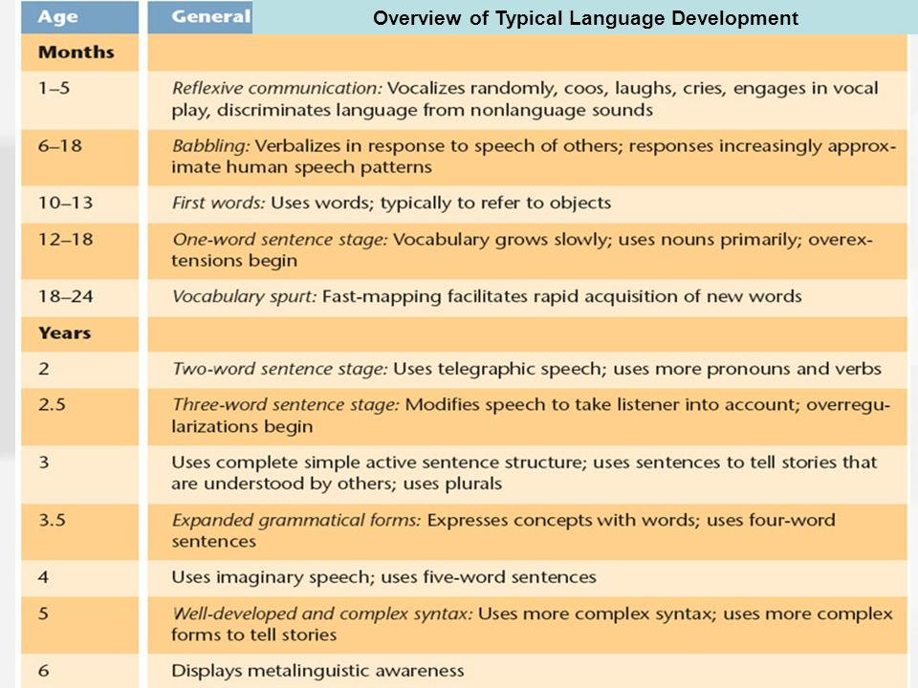
Language Development

Slide 14
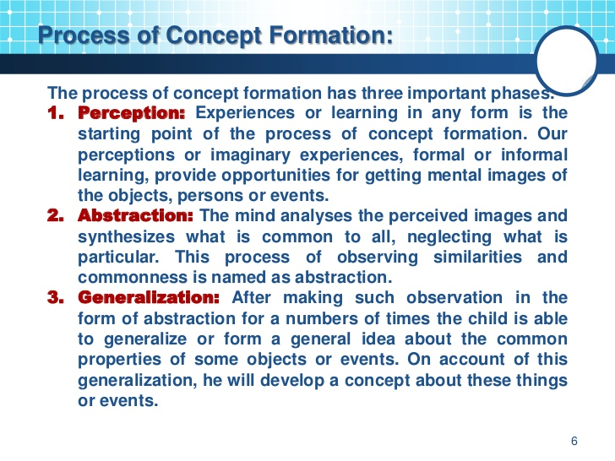

Slide 15
Decision making
Decision making can be regarded as an outcome of mental processes (cognitive process) leading to the selection of a course of action among several alternatives. Every decision making process produces a final choice. The output can be an action or an opinion of choice.

Slide 16
TECHNIQUES OF DECISION MAKING
Identify the purpose of your decision.
Gather information.
Identify the principles to judge the alternatives.
Brainstorm and list different possible choices.
Evaluate each choice in terms of its consequences.
Determine the best alternative.
Put the decision into action.
Evaluate the outcome of your decision and action steps.

Slide 17
PROBLEM SOLVING
Problem solving forms part of thinking. Considered the most complex of all intellectual functions, problem solving has been defined as higher-order cognitive process that requires the modulation and control of more routine or fundamental skills. It occurs if an organism or an artificial intelligence system does not know how to proceed from a given state to a desired goal state. It is part of the larger problem process that includes problem finding and problem shaping.

Slide 18
Types of Problems:
Problems are categorized in three ways:
Arrangement Problems require the problem solver to rearrange or recombine elements in a way that will satisfy a certain criterion. For example scrabble in which we arrange different letters to make word.
Inducing structure requires a solver to identify the existing relationship among the elements presented and then construct a new relationship among them.
Transformation problems gives you only the start and end state and the procedure or method to be followed, for example the problem of tower of Hanoi, in which 52 rings are to placed using the 3 pegs only with the condition that you cannot place a bigger ring on the smaller one.
Such problems are solved by the knowledge, Insight and hit and trial method (trial and error). Through practicing we can make our problem solving skills better.

Slide 19
Types of problems
Problems of Inducing Structure
  Requires people to discover the relations between numbers. Words, symbols or ideas.
  Analogy problems (Merchant: Sell::Customer:_____)
  Series completion problems (+-XX++--X++--X++-?X)
Problems of Arrangement
  Requires people to arrange the parts of a problem in a way that satisfies some criterion – usually there are many ways but only a few form a solution.

Slide 20
  Often solved with burst of insight
  Anagrams (elsnsmea =lameness)
  String Problem (There are two strings hanging from a ceiling but are too far apart to allow a person to hold one and walk to the other. On the floor are a book of matches, a screwdriver, and a few pieces of cotton. The goal is to tie the two pieces of string together)

Slide 21
Problems of Transformation
Requires people to carry out a sequence of transformations in order to reach a goal
Hobbits & Orcs
Water Jar Problem

Slide 22
Problem Solving (IDEAL)
John Branford and Berry Stain introduced the IDEAL method, a very basic type of method, for solving a problem:-
I = Identify your problem.
D = Define, specify and present your problem.
E = Explore possible strategies.
A = Act on the explored strategies and plans.
L = Look back and evaluate the results.

Slide 23
Problem solving methods are classified
as:
Algorithms
Heuristics

Slide 24
Algorithm is an approach to find a step by step solution to a problem. It is a rule that if applied appropriately, guarantees a solution to a problem.
Example of algorithmic approach:
You have given the two sides of a right angle triangle and have to find the third side. You have to ponder on the problem that is you are going to think on it and the steps will almost be:
Make a shape of right angle triangle in your mind (concept).
Get the length of the base of triangle.
Get the perpendicular of the triangle.
Now you will apply the Pythagoras theorem.
Finally, you will get a correct result.

Slide 25
Heuristic is a rule of thumb that can suggest a solution to a problem but it does not ensure that it will solve the problem. It is a cognitive shortcut that may lead to a solution.
Example of the heuristic approach:
You are playing tic-tac-toe, when you are going to start the game you will the cross at the center… why? The past experiences shows that placing your cross at the center will increase the probability of winning the game, again that does not ensure that you are going to win the game.

Slide 26
Failure in problem solving
Irrelevant information
  Functional fixedness
  Mental set

Slide 27
REASONING
Reasoning is the cognitive process of looking for reasons for beliefs, conclusions, actions or feelings. Although reasoning was once thought to be a uniquely human capability, other animals also engage in reasoning.
The mental activity of transforming information to reach conclusion.

Slide 28
Deductive Reasoning
Reasoning from general to specific. It begins with the series of assumptions or premises that are thought to be true. If assumptions are true then conclusion must be true.
One classic example of deductive reasoning is that found in syllogisms like the following:
  Premise 1: All humans are mortal.
  Premise 2: Socrates is a human.
  Conclusion: Socrates is mortal.

Slide 29
Inductive Reasoning
Reasoning from specific to general. It is a reasoning process where by a general rule is inferred from specific cases using Observation Knowledge and experience.
A classic example of inductive reasoning
:
  Premise: The sun has risen in the east every morning up until now.
  Conclusion: The sun will also rise in the east tomorrow.

Slide 30
Creativity
Creativity involves the generation of original, novel, and useful ideas. Creativity does not usually involve sudden insight, and it consists of more than divergent thinking.
Based on analysis of over 80 studies, Fiest (1988) concluded that highly creative people are more autonomous, introverted, open to new experiences, norm-doubting, ambitious, dominant , hostile and impulsive. Though creativity is only weakly related to intelligence,

Slide 31
Creative Thinking Process
Preparation where much of the work is done.
Incubation the process of thinking about a problem subconsciously while being involved in other activities.
Illumination where the idea or ideas come to you suddenly.
Verification where you work out the creative idea and turn it into something worthwhile.

Slide 32
Traits of Creative People
Expertise,Imaginative,Integrative personality
Intrinsic motivation, Divergent thinker, independent.
Why We Give up Being Creative?
Convergent thinking is encouraged where as divergent thinking is neglected.

Slide 33
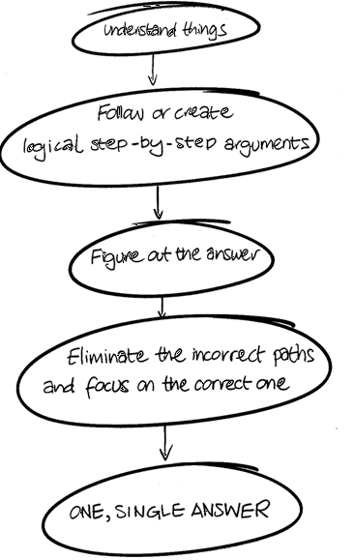

Slide 34
Creative Summary
The creative process can be divided into 4 stages: preparation, incubation, illumination, and verification. In the first stage, your brain is gathering information. After all, creative ideas don’t come from a vacuum. In the second stage, you let your mind wander and stretch your ideas. In the third stage, you make connections between ideas. In the fourth stage, creative ideas need to be polished by critical thinking in order to persuasively reach their audience.

Slide 35
Intelligence
Intelligence is goal directed and adaptive behavior. A property of the mind that encompasses many related abilities, such as the capacities to reason, to plan, to solve problems, to think abstractly, to comprehend ideas, to use language, and to learn.
The capacity to understand the world, think rationally, and use resources effectively when faced with challenges

Slide 36
Robert Sternberg - Triarchic Theory of
Intelligence:
Psychologist Robert Sternberg defined intelligence as "mental activity directed toward purposive adaptation to, selection and shaping of, real-world environments relevant to one’s life". Sternberg proposed what he refers to as 'successful intelligence,' which is comprised of three different factors:
Analytical intelligence: This component refers to problem-solving abilities.
Creative intelligence: This aspect of intelligence involves the ability to deal with new situations using past experiences and current skills.
Practical intelligence: This element refers to the ability to adapt to a changing environment.

Slide 37
EMOTIONAL INTELLIGENCE
The Emotional Competencies (Goleman) model
The model introduced by Daniel Goleman focuses on EI as a wide array of competencies and skills that drive leadership performance. Goleman's model outlines four main EI constructs:
Self-awareness — the ability to read one's emotions and recognize their impact while using gut feelings to guide decisions.
Self-management — involves controlling one's emotions and impulses and adapting to changing circumstances.
Social awareness — the ability to sense, understand, and react to others' emotions while comprehending social networks.
Relationship management — the ability to inspire, influence, and develop others while managing conflict.

Slide 38
Mental Age
IQ (Intelligence)
EQ (Emotional Intelligence): Some psychologists broaden the concept of intelligence even further beyond the intellectual realm to include emotions.
Emotional intelligence is the set of skills that underlie the accurate assessment, evaluation, expression, and regulation of emotions.
The first Intelligence test was created by Binet and Simon using simple tasks to distinguish children who would do well in school from those who wouldn’t.
Binet and Simon used Mental age to distinguish “bright” from “dull” children

Slide 39
Concept of Mental Age (Alfred Binet)
Alfred Binet was a psychologist. His greatest accomplishment in the field of psychology lead to what we now call the Intelligence Quotient or IQ. He developed a test to measure the 'mental age' (MA) of children entering school. Mental age refers to the child's current ability compared to other children of different ages. In other words, if a child responded to questions at about the same correctness as an eight year old, the child would be said to have a mental age of eight.

Slide 40
Concept & Formula of I.Q (William Stern )
MA / CA X 100
Mental age divided by chronological age multiplied by hundred.
The mean I.Q. for the general population is 100.

Slide 41
Mental Retardation
Types of mental retardation
Causes of mental retardation
Intelligence tests

Slide 42
Quick IQ test
Water lilies double in area every 24 hours. At the beginning of the summer, there is one water lily on a lake. It takes 60 days for the lake to become covered with water lilies. On what day is the lake half-covered?
A farmer has 17 sheep. All but 9 break through a hole in the fence and wander away. How many are left?

Slide 43
3.If you have black socks and brown socks in your drawer, mixed in a ratio of 4 to 5. How many socks will you have to take out in order to have a pair of the same color?
4.With a 7-minute hourglass, and an 11-minute hourglass, how can you time the boiling of an egg for 15-minutes

Slide 44
Rubrics
On day 59. Remember, it doubles every day.
Nine sheep. It is just a matter of careful reading.
Three socks. The ratio information is irrelevant.

Slide 45
4.Allow both glasses to drain simultaneously. As soon as the 7-minute glass empties, flip it over (7 minutes have expired). Then, flip it over again after the 11-minute glass empties (11 minutes have expired). Fifteen minutes will have passed when the 7-minute

